Slide 1
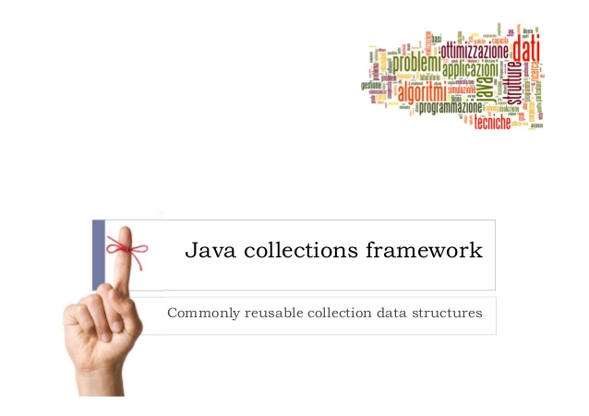
exceptions

Slide 2
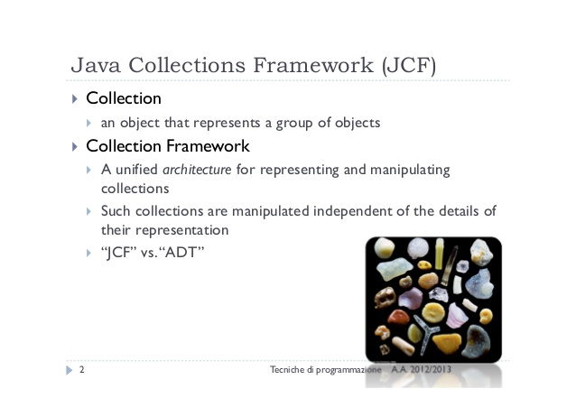
exceptions

Slide 3
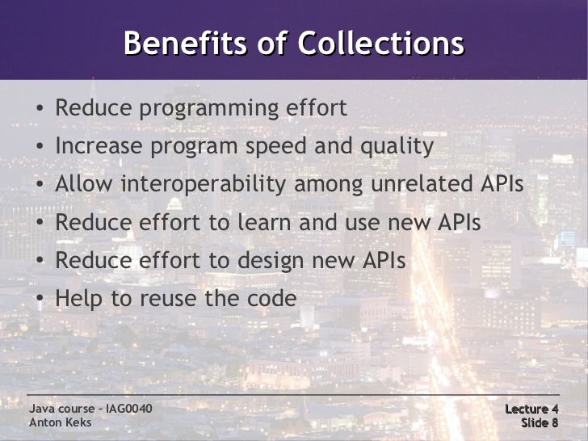
exceptions

Slide 4
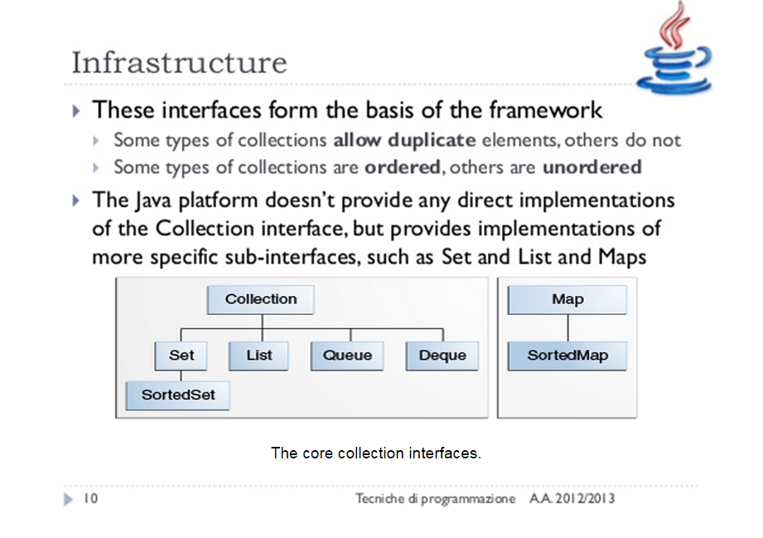
exceptions

Slide 5
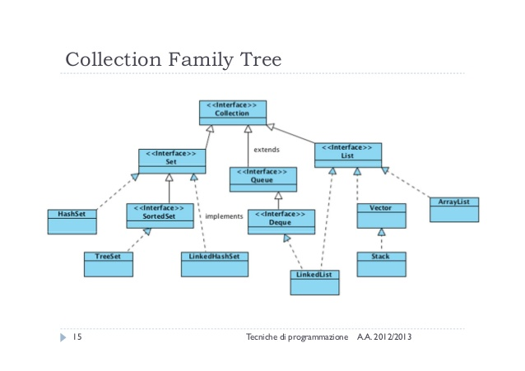
exceptions

Slide 6
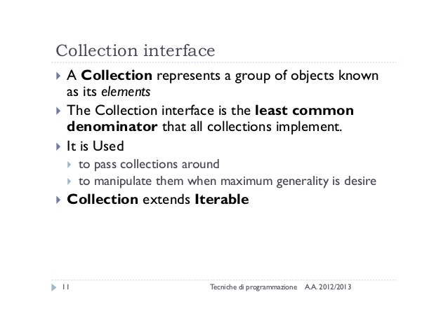
exceptions

Slide 7
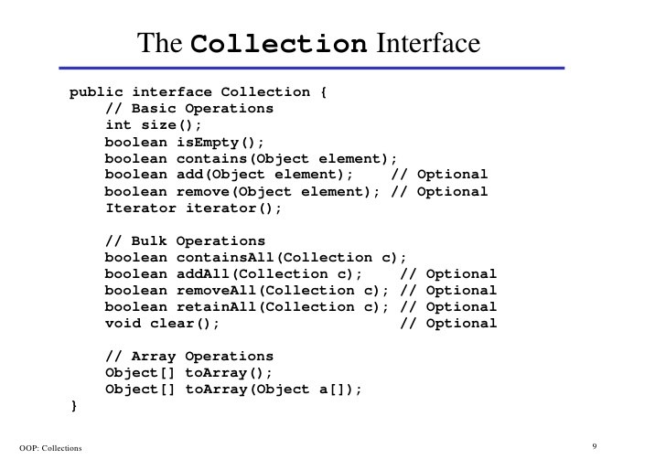
inheritance

Slide 8
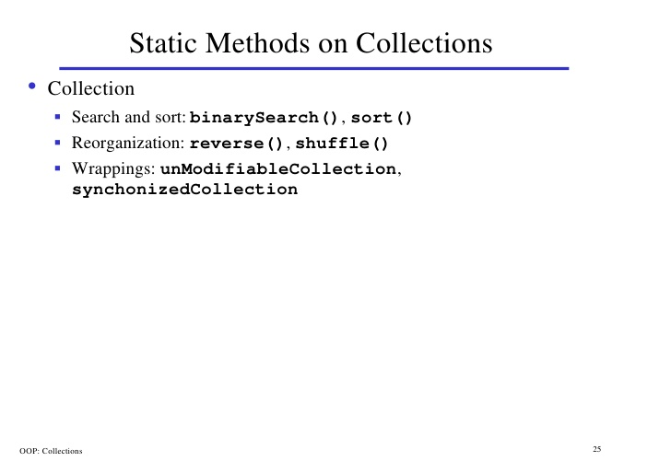
inheritance

Slide 9
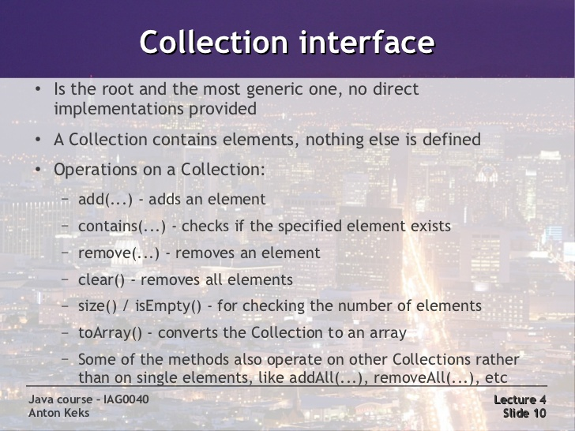
exceptions

Slide 10
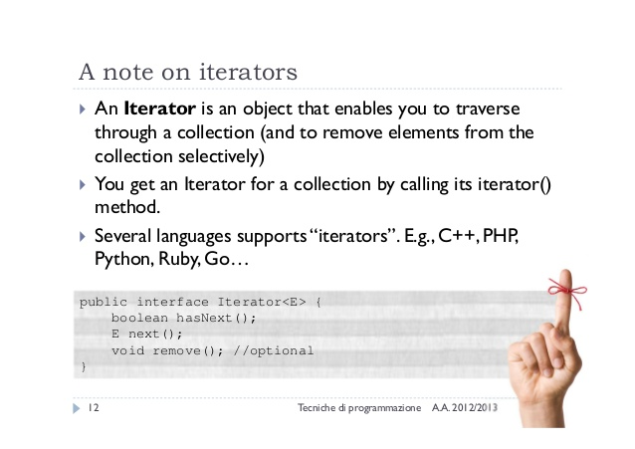
exceptions

Slide 11
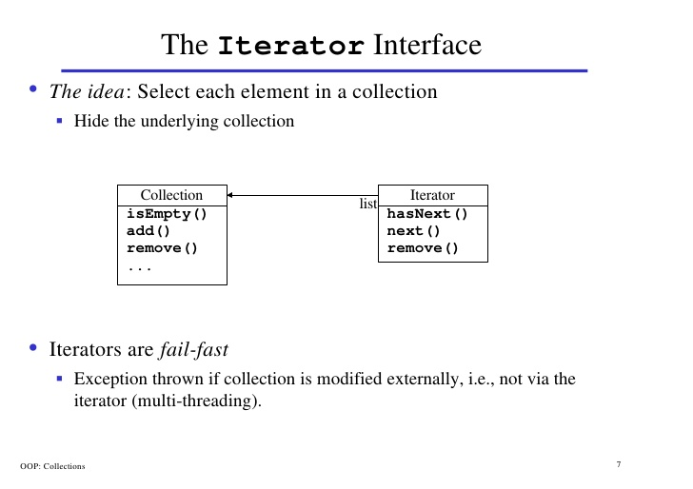
inheritance

Slide 12
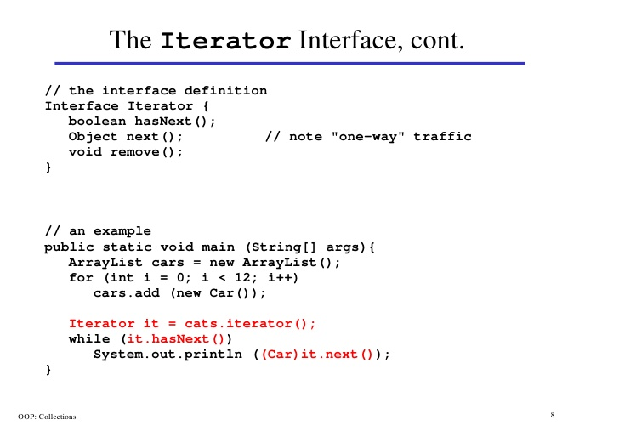
inheritance

Slide 13
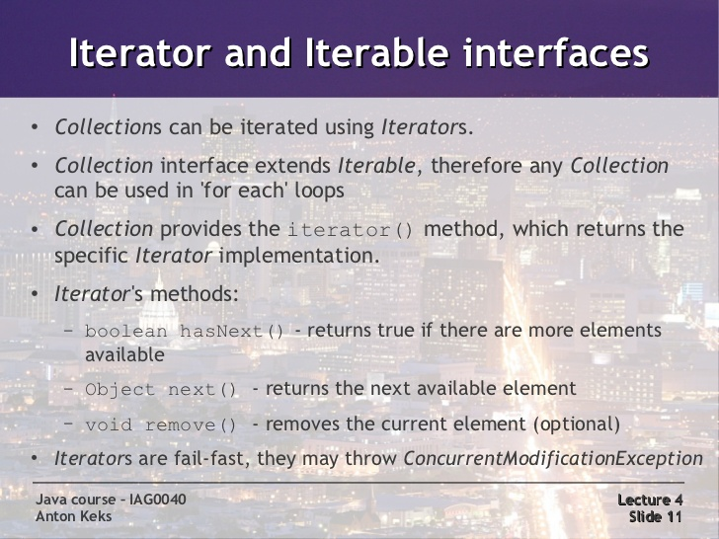
exceptions

Slide 14
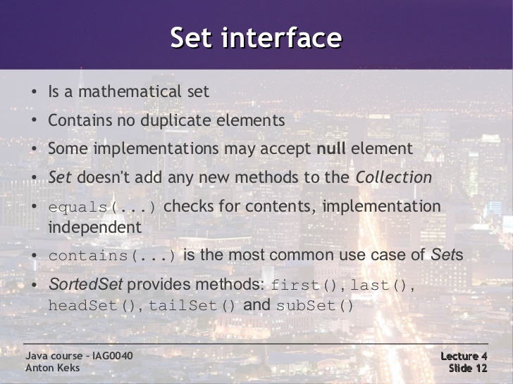
exceptions

Slide 15
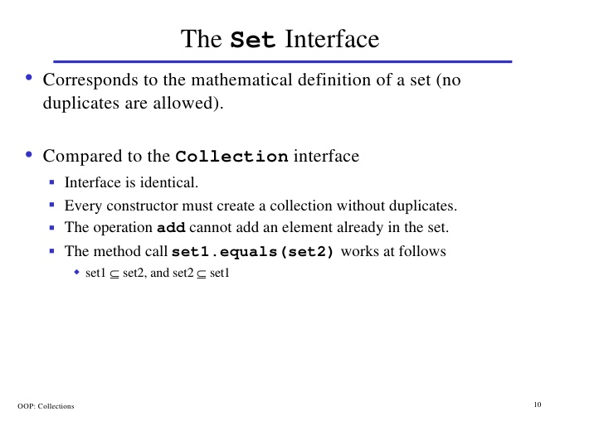
inheritance

Slide 16
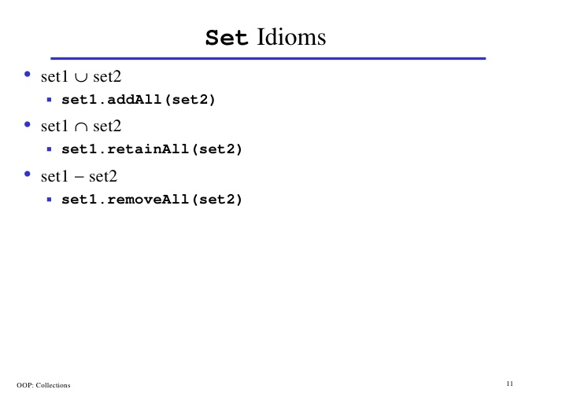
inheritance

Slide 17
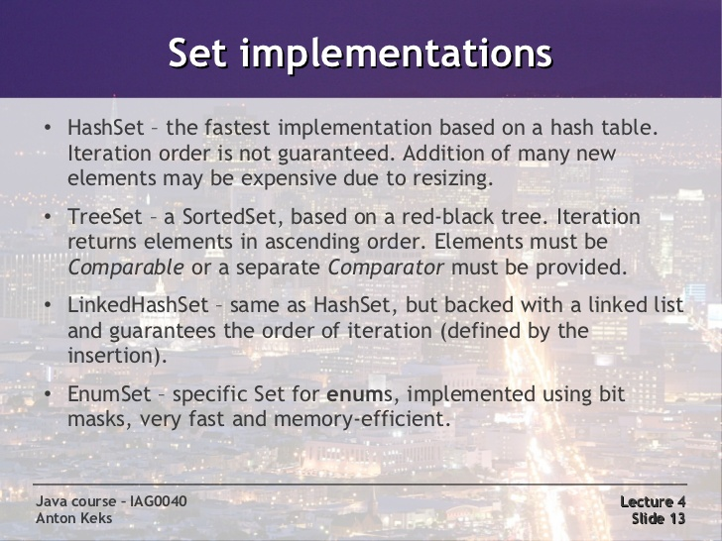
exceptions

Slide 18
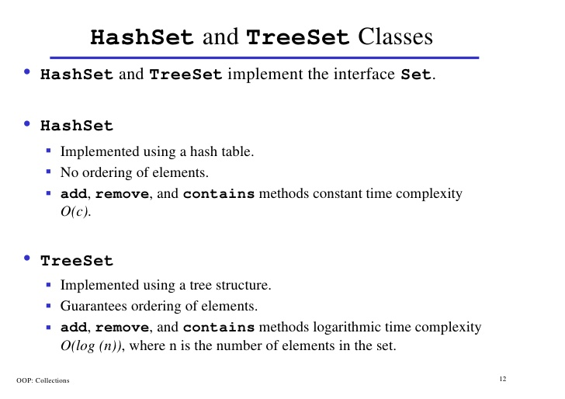
inheritance

Slide 19
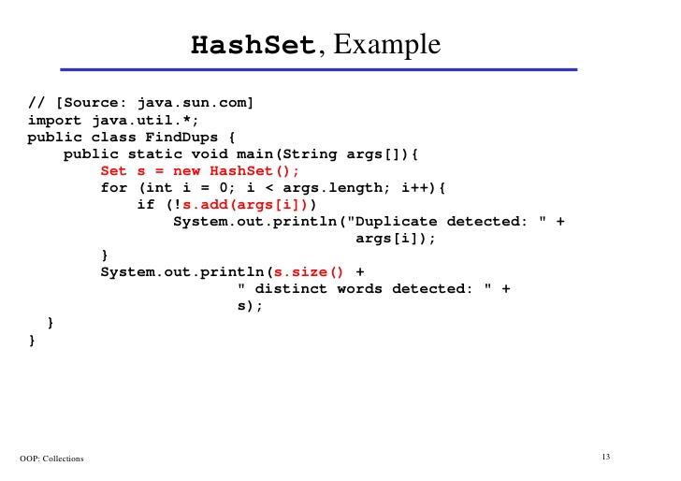
inheritance

Slide 20
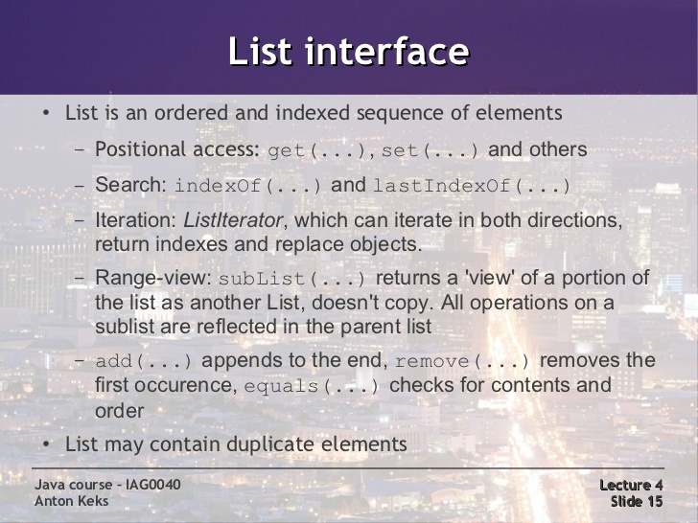
exceptions

Slide 21
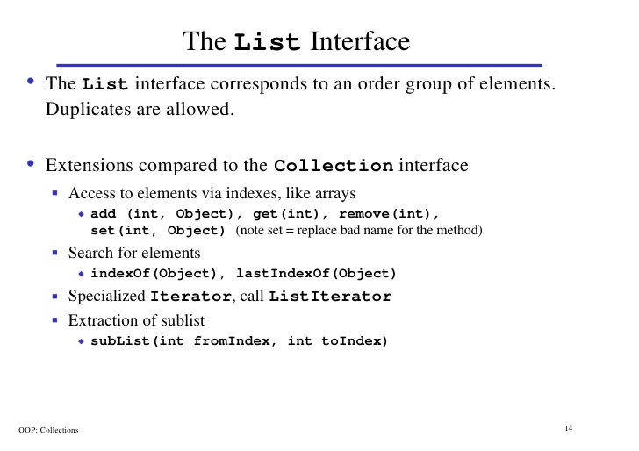
inheritance

Slide 22
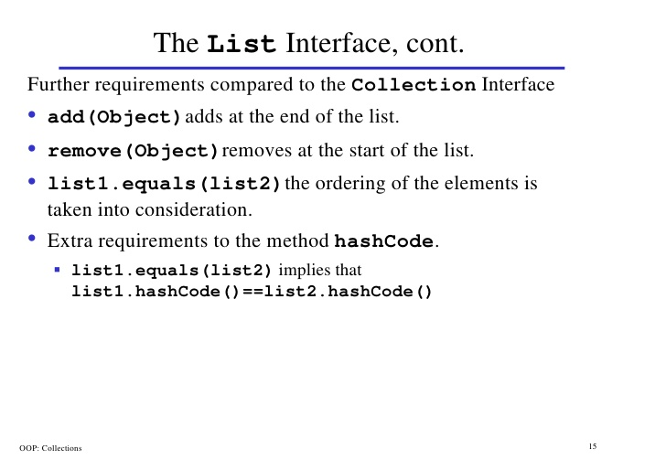
inheritance

Slide 23
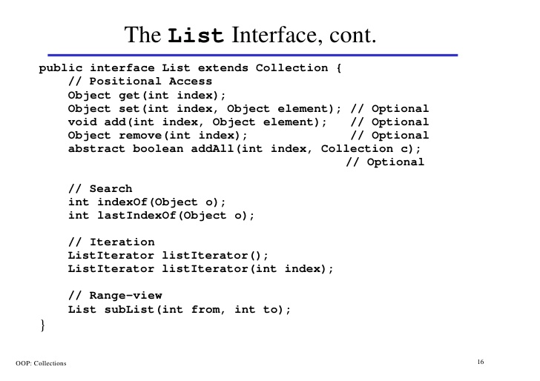
inheritance

Slide 24
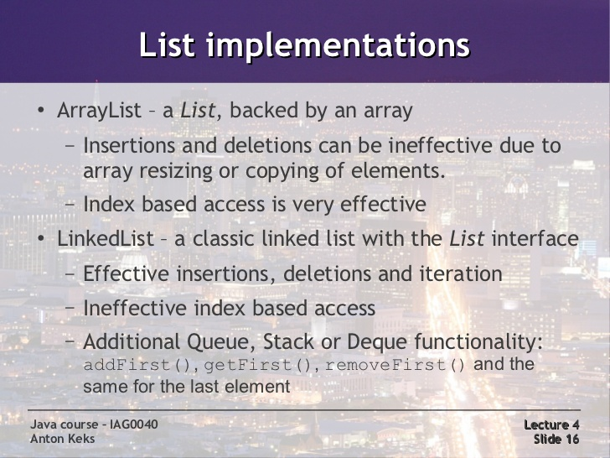
exceptions

Slide 25
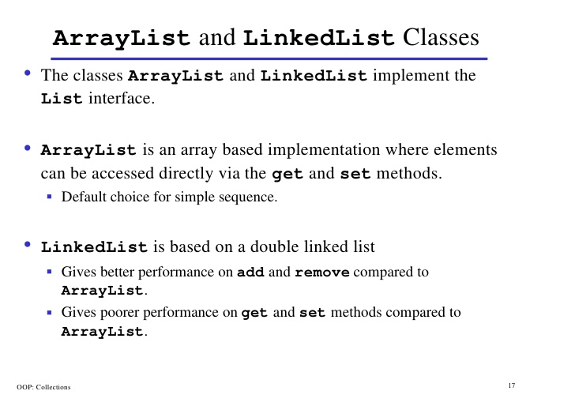
inheritance

Slide 26
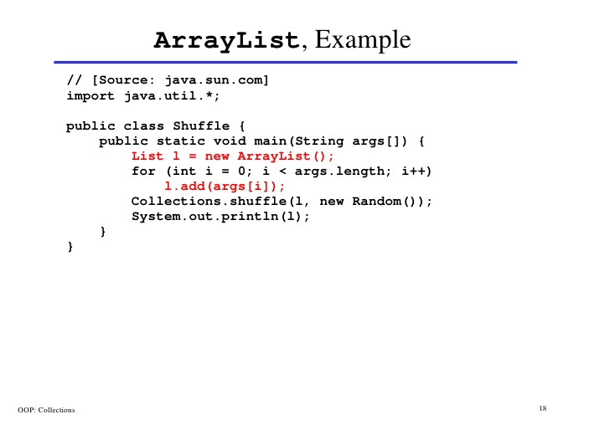
inheritance

Slide 27
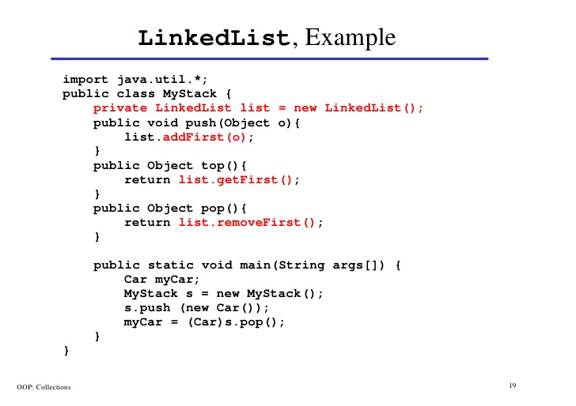
inheritance

Slide 28
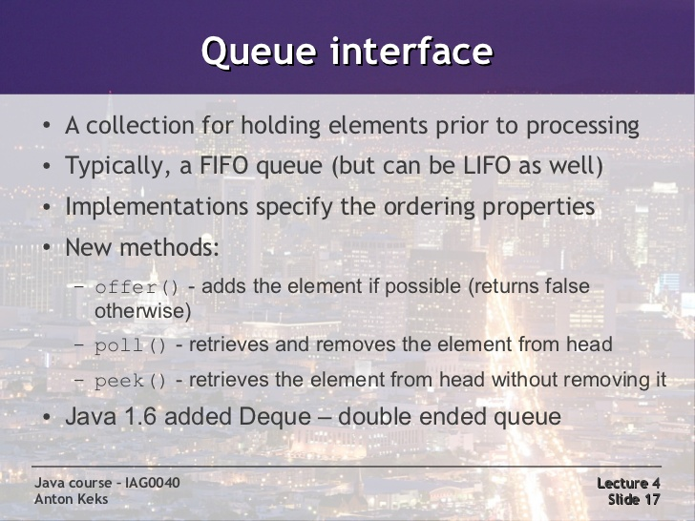
exceptions

Slide 29
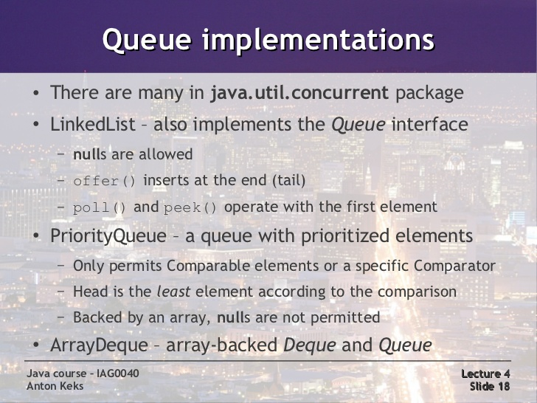
exceptions

Slide 30
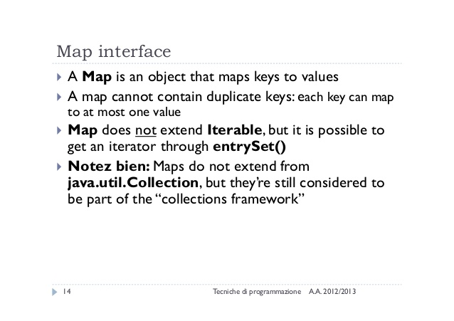
exceptions

Slide 31
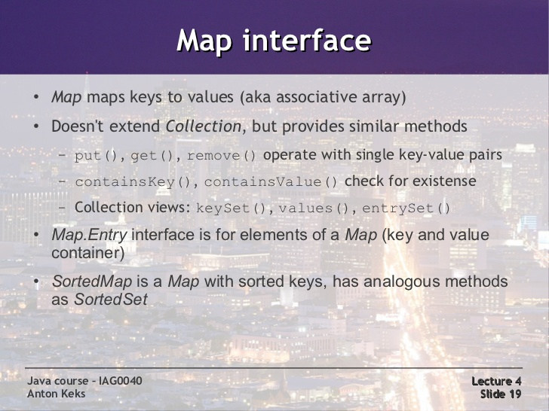
exceptions

Slide 32
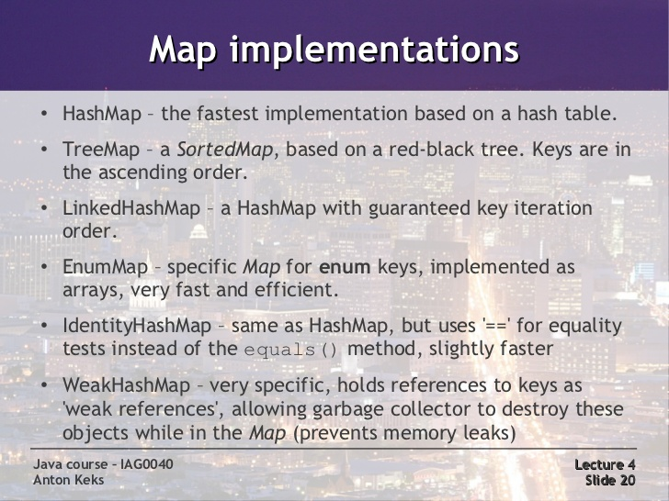
exceptions

Slide 33
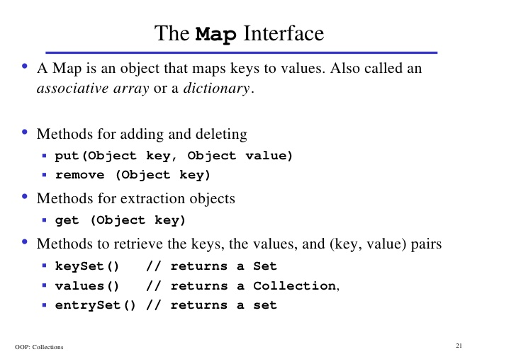
inheritance

Slide 34
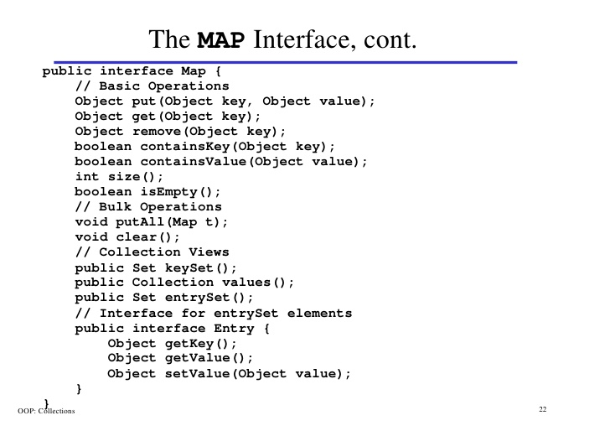
inheritance

Slide 35
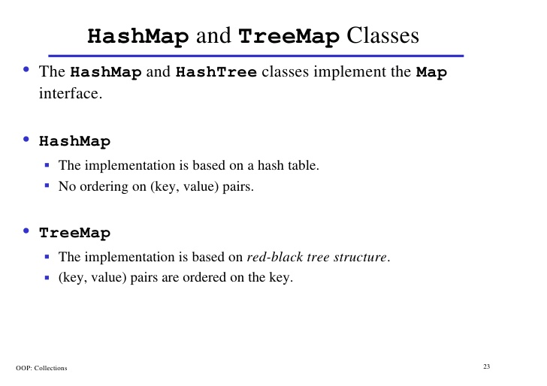
inheritance

Slide 36
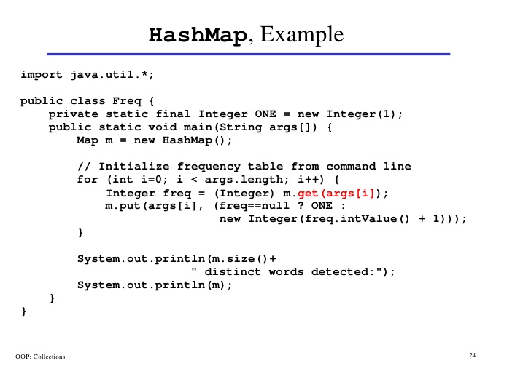
inheritance

Slide 37
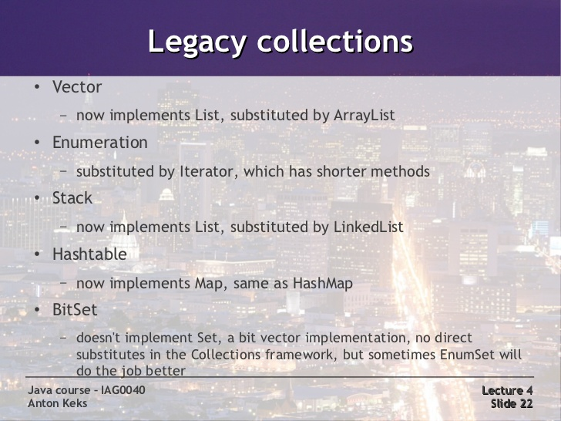
exceptions

Slide 38
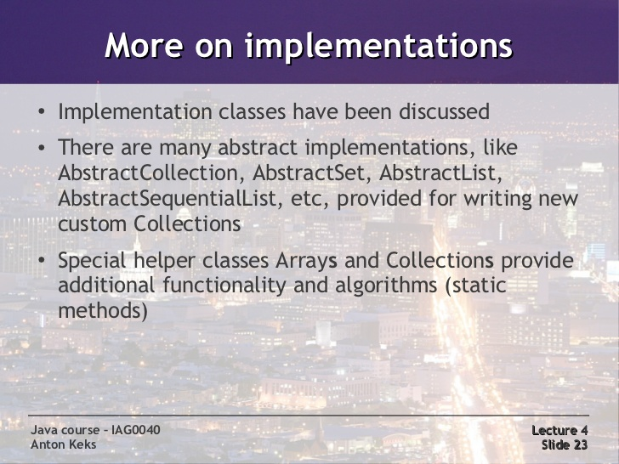
exceptions

Slide 39
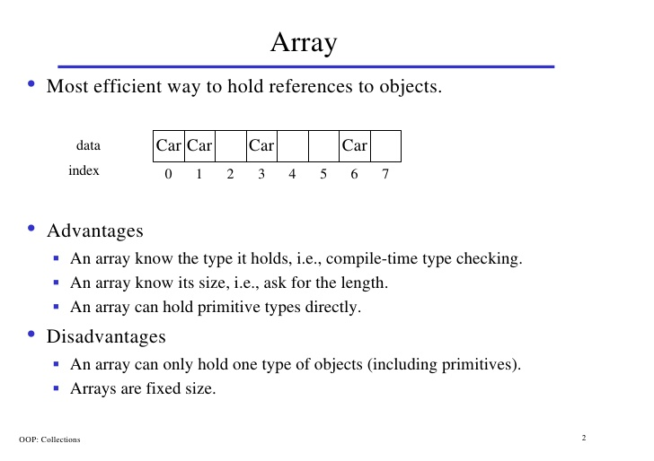
inheritance

Slide 40
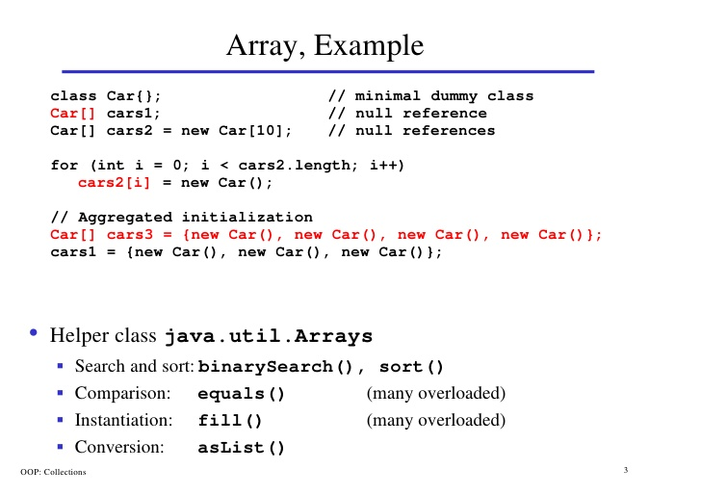
inheritance

Slide 41
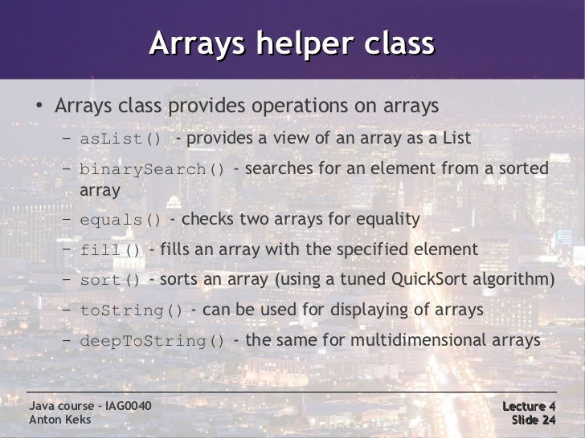
exceptions

Slide 42
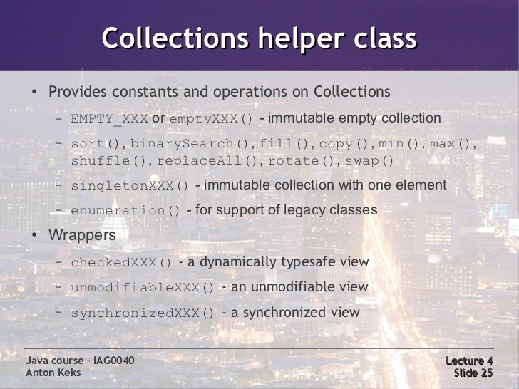
exceptions

Slide 43
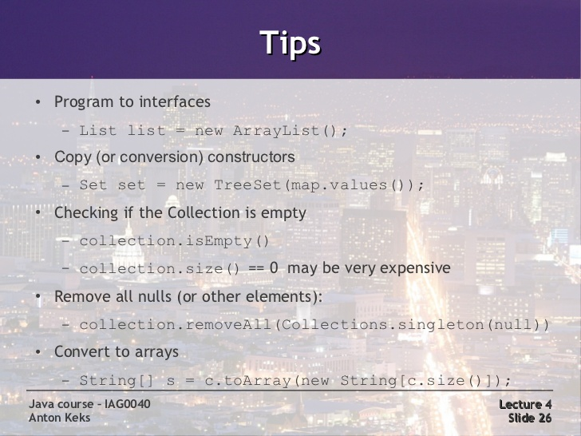
exceptions

Slide 44
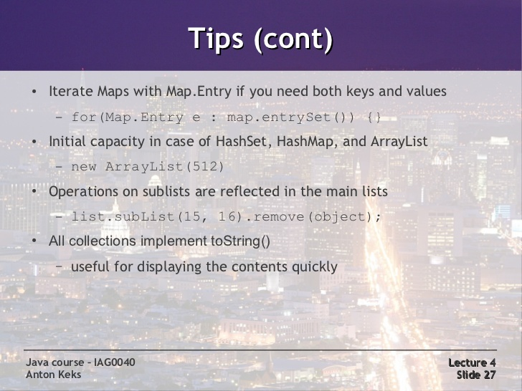
exceptions

Slide 45
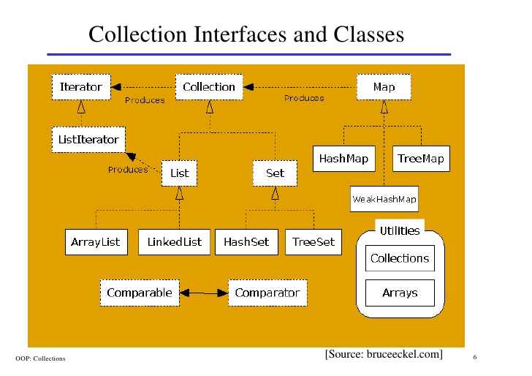
inheritance

Slide 46
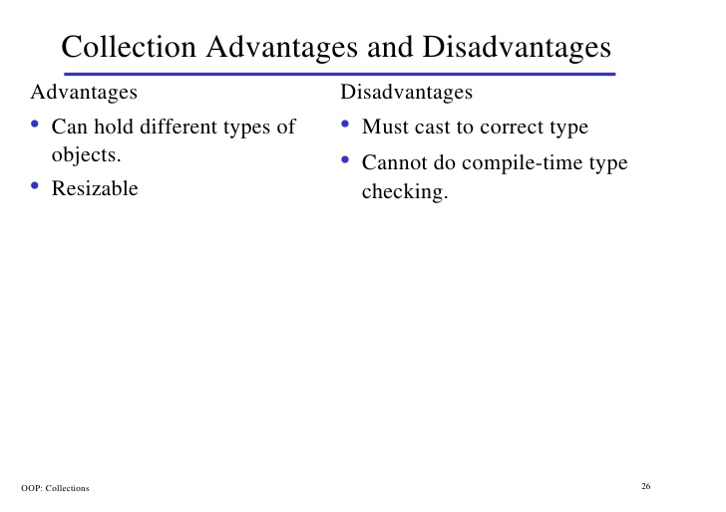
inheritance

Slide 47
exceptions

Slide 48
exceptions

Slide 49
exceptions

Slide 50
exceptions

Slide 51
exceptions

Slide 52
exceptions

Slide 53
exceptions
Collections – A container is an object that groups multiple elemen its together in a single unit.
Used to store, retrieve, manipulate and communicate aggregate data.

Slide 54
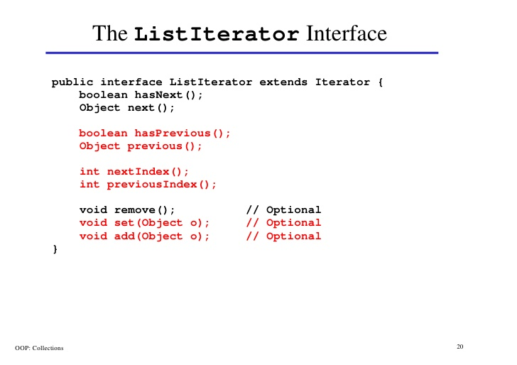
inheritance

Slide 55
inheritance

Slide 56
inheritance

Slide 57
inheritance

Slide 58
inheritance

Slide 59
inheritance

Slide 60
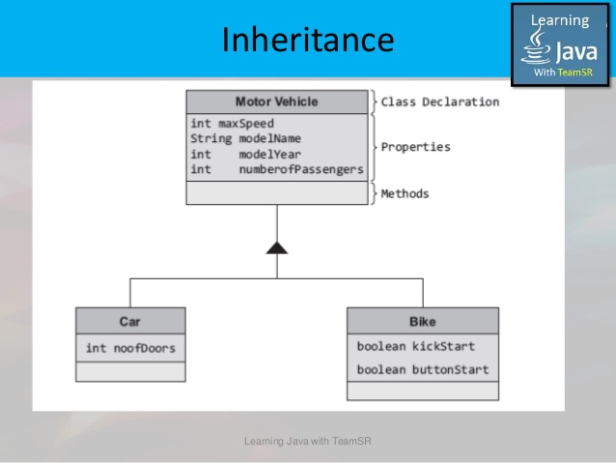
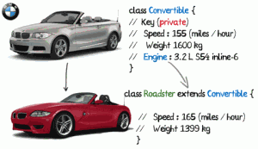
inheritance

Slide 61
Interfaces and inheritance

Slide 62
Java - miscellaneous
Type Comparison Operator instanceof
The instanceof operator compares an object to a specified type.
You can use it to test if an object is an instance of a class, an instance of a subclass, or an instance of a class that implements a particular interface
Classes implementing interfaces
class MyClass extends MySuperClass implements YourInterface {
// field, constructor, and
// method declarations
}

Slide 63
Java - miscellaneous
Varargs – Specifying Arbitrary number of arguments
public Polygon polygonFrom(Point... corners) {
int numberOfSides = corners.length;
double squareOfSide1, lengthOfSide1;
squareOfSide1 = (corners[1].x - corners[0].x)
* (corners[1].x - corners[0].x)
+ (corners[1].y - corners[0].y)
* (corners[1].y - corners[0].y);
lengthOfSide1 = Math.sqrt(squareOfSide1);
// more method body code follows that creates and returns a
// polygon connecting the Points
}
You will most commonly see varargs with the printing methods; for example, this printf method:
public PrintStream printf(String format, Object... args)
allows you to print an arbitrary number of objects. It can be called like this:
System.out.printf("%s: %d, %s%n", name, idnum, address);

Slide 64
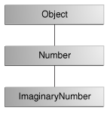
Java - miscellaneous
Returning a Class or Interface
When a method uses a class name as its return type the class of the type of the returned object must be either a subclass of, or the exact class of, the return type.
public Number returnANumber() {
...
}
The returnANumber method can return an ImaginaryNumber but not an Object. ImaginaryNumber is a Number because it's a subclass of Number. However, an Object is not necessarily a Number — it could be a String or another type

Slide 65
Advanced java
Garbage collection
JDBC
Lambda expressions
Annotations

Slide 66
https://docs.oracle.com/javase/tutorial/reallybigindex.html
http://www.slideshare.net/EdurekaIN/java-class-3
http://www.slideshare.net/abdurrehmanabdurrehman391/variables-and-data-types-by-sir-khalid
http://www.slideshare.net/abdurrehmanabdurrehman391/java-advancedoop
http://www.slideshare.net/MindfireSolutions/java-garbage-collection-how-it-works?next_slideshow=1
http://www.slideshare.net/arnold7490/unit-4-java
http://www.slideshare.net/arnold7490/unit-3-java?next_slideshow=1
http://www.slideshare.net/tushardesarda/java-tutorial-3
http://www.slideshare.net/muralidhar9e/java-exception-handling-ppt
http://www.slideshare.net/emprovise/2-javabasics
http://www.slideshare.net/AllanHuang/java-new-evolution
http://www.slideshare.net/antonkeks/4-collections

